Slide 1

B Tree; Binary Heaps
Data Structure | Tree and Heap
Course: Data Structure | Chapter: Tree and Heap | Bachelor of Engineering
DISCOVER · LEARN · EMPOWER
Notes:
Welcome everyone to today's lecture on B Trees and Binary Heaps. These structures are fundamental for efficient data storage and retrieval in modern systems. We will explore how they differ from standard binary search trees and why they are critical for database indexing and priority queues.

Slide 2
Course Outcomes
SLIDE 2 / 14
Course Outcome
CO | BT LEVEL | DESCRIPTION
CO1 | BT1 | Understand and apply basic data structures, algorithms, complexity analysis, ADTs, arrays and linked lists.
CO2 | BT2 | Apply and implement stacks and queues in problem-solving.
CO3 | BT3 | Analyse and apply searching, sorting, and hashing techniques.
CO4 | BT4 | Construct and apply tree structures and traversal techniques.
CO5 | BT5 | Represent and solve graph problems using DFS, BFS, and graph algorithms.
Chandigarh University
2 / 14
Notes:
Today's session directly addresses our Course Outcomes. CO1 requires you to understand and apply basic data structures, which includes the complex B Tree and Binary Heap. CO2 focuses on applying these structures in problem-solving, particularly for priority queues and search optimization.

Slide 3
Learning Objectives
SLIDE 3 / 14
Learning Outcomes
1
Define the structural properties of B Trees and Binary Heaps.
2
Explain the operational differences between B Trees and Binary Search Trees.
3
Demonstrate the insertion process for Binary Heaps with examples.
4
Analyze the time complexity for search, insert, and delete operations.
5
Identify real-world applications for both data structures.
Chandigarh University
3 / 14
Notes:
By the end of this lecture, you will be able to define the structural properties of B Trees and Binary Heaps. You will also explain the operational differences between B Trees and Binary Search Trees. Finally, we will demonstrate the insertion process for Binary Heaps with concrete examples.

Slide 4
Lecture
SLIDE 4 / 14
B Tree Definition and Properties
1
A B Tree is a self-balancing m-way search tree structure.
2
All leaf nodes appear at the same depth level in the tree.
3
Every node contains at most m children and m-1 keys.
4
Internal nodes must have at least ceil(m/2) children except root.
5
Keys within a node are always sorted in ascending order.
6
The root node must have at least two children if not a leaf.
Chandigarh University
4 / 14
Notes:
A B Tree is a self-balancing m-way search tree structure designed for systems with large data. All leaf nodes appear at the same depth level, ensuring balanced access ×. Every node contains at most m children and m-1 keys, which allows for efficient disk I/O operations.

Slide 5
Lecture
SLIDE 5 / 14
B Tree Node Structure
1
A node contains n keys and n+1 pointers to child nodes.
2
Keys k1, k2, ... kn divide the search space into ranges.
3
Pointer p1 points to keys less than k1, p2 to k1-k2.
4
The root node is the entry point for all search operations.
5
Leaf nodes contain no children pointers but store actual data.
6
The order m defines the maximum branching factor of the tree.
Chandigarh University
5 / 14
Notes:
A node contains n keys and n+1 pointers to child nodes, creating a branching factor. Keys k1, k2, ... kn divide the search space into ranges for efficient navigation. Pointer p1 points to keys less than k1, while p2 points to keys between k1 and k2.

Slide 6
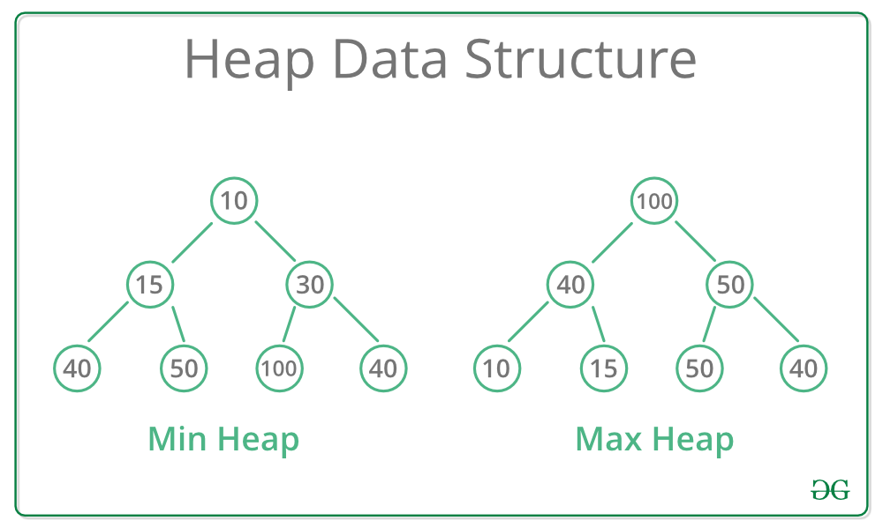
Lecture
SLIDE 6 / 14
Binary Heap Definition and Types
MAX HEAP PROPERTY
Parent key is always greater than children.
MIN HEAP PROPERTY
Parent key is always smaller than children.
• A Binary Heap is a complete binary tree satisfying the heap property.
• The root node holds the maximum or minimum element of the heap.
• The tree is filled level by level from left to right.
• It is typically implemented using an array for space efficiency.
Source: media.geeksforgeeks.org
Chandigarh University
6 / 14
Notes:
A Binary Heap is a complete binary tree satisfying the heap property, ensuring efficient access to the extremum. Max Heap property dictates that the parent key is always greater than children. Min Heap property dictates that the parent key is always smaller than children.

Slide 7
Lecture
SLIDE 7 / 14
Array Representation of Binary Heap
1
Root element is stored at index 1 of the array.
2
Left child of node i is located at index 2i.
3
Right child of node i is located at index 2i + 1.
4
Parent of node i is located at index floor(i/2).
5
This representation eliminates the need for explicit pointer storage.
6
The array size must be sufficient to hold all tree nodes.
Chandigarh University
7 / 14
Notes:
Root element is stored at index 1 of the array, simplifying memory management. Left child of node i is located at index 2i, while right child is at index 2i + 1. Parent of node i is located at index floor(i/2), allowing easy traversal up the tree.

Slide 8
Lecture
SLIDE 8 / 14
B Tree Insertion Process
1
Search for the correct leaf node to insert the new key.
2
If the leaf node has space, insert the key in sorted order.
3
If the leaf node is full, split the node into two.
4
The middle key is promoted to the parent node for balancing.
5
If the root splits, a new root is created increasing tree height.
6
This process maintains the self-balancing property of the B Tree.
Chandigarh University
8 / 14
Notes:
Search for the correct leaf node to insert the new key, ensuring sorted order. If the leaf node has space, insert the key directly. If the leaf node is full, split the node into two, promoting the middle key to the parent node.

Slide 9

Lecture
SLIDE 9 / 14
Binary Heap Insertion Example
FINAL HEAP STRUCTURE
[5, 8, 10, 12] with 5 as root.
• Insert key 10 into a Min Heap containing [5, 8, 12].
• Place 10 at the next available leaf position in the array.
• Compare 10 with its parent 12; 10 is smaller, so swap.
• Compare 10 with new parent 5; 10 is larger, stop swapping.
• This 'bubble up' operation ensures the heap property is restored.
Source: images.twinkl.co.uk
Chandigarh University
9 / 14
Notes:
Insert key 10 into a Min Heap containing [5, 8, 12]. Place 10 at the next available leaf position in the array. Compare 10 with its parent 12; since 10 is smaller, swap them. Compare 10 with new parent 5; since 10 is larger, stop swapping.

Slide 10
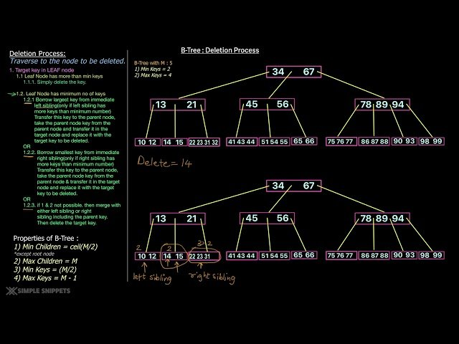
Lecture
SLIDE 10 / 14
B Tree Deletion Process
1
Locate the key to be deleted in the tree structure.
2
If in a leaf node, simply remove the key if space permits.
3
If in an internal node, replace with predecessor or successor.
4
If the resulting node has too few keys, borrow or merge.
5
Borrowing takes a key from a sibling with extra keys.
6
Merging combines the node with a sibling and pulls down a parent key.
Source: d3f1iyfxxz8i1e.cloudfront.net
Chandigarh University
10 / 14
Notes:
Locate the key to be deleted in the tree structure. If in a leaf node, simply remove the key if space permits. If in an internal node, replace with predecessor or successor to maintain order. If the resulting node has too few keys, borrow or merge.

Slide 11
Lecture
SLIDE 11 / 14
Binary Heap Deletion Example
FINAL HEAP STRUCTURE
[5, 10, 8] with 5 as new root.
• Delete the root (minimum) from a Min Heap [2, 5, 8, 10].
• Replace root with the last element in the array (10).
• Compare 10 with children 5 and 8; swap with smaller child 5.
• Compare 10 with new children; 10 is larger, so stop.
• This 'bubble down' operation restores the heap property efficiently.
Chandigarh University
11 / 14
Notes:
Delete the root (minimum) from a Min Heap [2, 5, 8, 10]. Replace root with the last element in the array, which is 10. Compare 10 with children 5 and 8; swap with the smaller child 5. Compare 10 with new children; since 10 is larger, stop.

Slide 12
Lecture
SLIDE 12 / 14
Complexity Analysis Comparison
1
B Tree search, insert, delete take O(log_m n) time complexity.
2
Binary Heap search takes O(n) time for arbitrary elements.
3
Binary Heap insert and delete take O(log n) time complexity.
4
B Trees are optimized for disk-based storage with large blocks.
5
Binary Heaps are optimized for memory-based priority queue operations.
6
B Trees maintain sorted order for range queries effectively.
Chandigarh University
12 / 14
Notes:
B Tree search, insert, delete take O(log_m n) time complexity, making them ideal for databases. Binary Heap search takes O(n) time for arbitrary elements, but insert and delete take O(log n). B Trees are optimized for disk-based storage with large blocks.

Slide 13
Lecture
SLIDE 13 / 14
Key Takeaways
1
B Trees are balanced m-way trees ideal for database indexing.
2
Binary Heaps are complete binary trees for priority queue management.
3
B Trees maintain sorted order and support efficient range queries.
4
Binary Heaps use array representation for space-efficient storage.
5
Both structures ensure logarithmic time complexity for core operations.
Chandigarh University
13 / 14
Notes:
B Trees are balanced m-way trees ideal for database indexing and large datasets. Binary Heaps are complete binary trees for priority queue management and sorting algorithms. Both structures ensure logarithmic time complexity for core operations, making them essential tools for engineers.

Slide 14
Lecture
SLIDE 14 / 14
References
DATA STRUCTURES
A Pseudocode Approach with C — Gilberg, Forouzan
• Data Structures — Lipschutz
• Data Structure Using C — AK Sharma
• C and Data structure — P. S. Deshpandey
Chandigarh University
14 / 14
Notes:
Please refer to the recommended textbooks for deeper understanding and practice problems. 'Data Structures: A Pseudocode Approach with C' by Gilberg and Forouzan provides excellent pseudocode examples. 'Data Structures' by Lipschutz and 'Data Structure Using C' by AK Sharma are also highly recommended for this topic.

